Slide 2
SBA COVID-19 disaster programs
for Child Care Providers
What we will cover today:
SBA Paycheck Protection Program (PPP)
SBA Economic Injury Disaster Loan (EIDL)
Disaster recovery business assistance

Slide 3

Benefits of the SBA PPP Program
The Paycheck Protection Program was designed to provide a direct incentive for small businesses to keep their employees on the payroll.
SBA may forgive all or a portion of your PPP loan if the same number of employees are kept on or rehired during the covered period of eight or 24 weeks and the money is used for eligible payroll, rent, mortgage interest, or utilities expenses.
There are “safe harbors” such as not bringing everyone back due to COVID-19 restrictions, employees are rejecting good faith offers to rehire, and restoring the number of employees or wage levels by December 31.

Slide 4
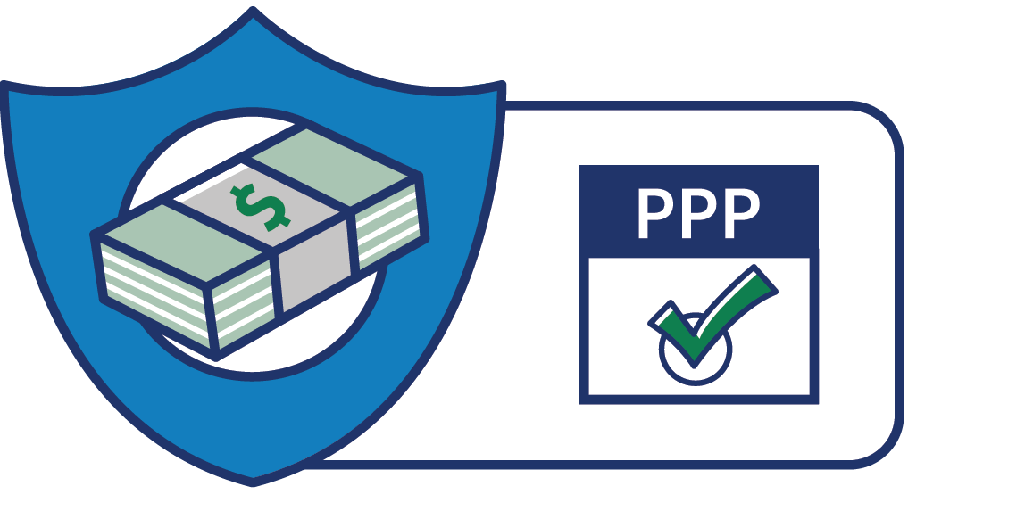
Paycheck Protection Program (PPP)
Status of PPP Loan program:
Funding remains available. We encourage small businesses to apply thru a PPP lender (banks, credit unions, VEDA, some Fintech lenders)
PPP application deadline is August 8th. PPP must be approved and funded before midnight 8/8. We recommend you apply asap as lenders may stop accepting new applications in order to process all applications before the deadline.
Application form, FAQ’s and regulations are available on the Treasury website www.treasury.gov/cares

Slide 5
PPP not your typical loan
The maximum loan amount (max. $10 million) is determined by “Average Monthly Payroll costs” during a certain period (generally 2019), multiplied by 2.5.
100% of loan amount MAY be forgivable
No collateral, no personal guarantees
Money is only to be used for payroll costs (at least 60%) and some eligible non-payroll costs (no more than 40%)

Slide 6
Will the PPP pay my salary as sole proprietor?
The PPP loan amount is determined by the 2019 monthly average payroll x 2.5. For Sole proprietors or Owner employees, their compensation amount will be 2.5 x equivalent 2019 monthly compensation capped at $15,384 for an 8-week covered payroll period or $20,833 for a 24-week covered period (Cap is due to $100,000 maximum cash compensation which is prorated as appropriate)
For sole proprietors no employees, take 2019 net profit on Schedule C, divide by 12, multiply by 2.5 and that is your PPP loan amount.
For sole proprietors with employees you will add your 2019 compensation (Schedule C net profit), employee gross wages, health insurance premiums paid by you for employees, contributions to retirement for employees and state employer taxes (unemployment insurance), divide by 12 and multiply by 2.5

Slide 7
PPP Flexibility Act of June 5th
Changes for the Better
Time to use the PPP loan funds was extended from 8 weeks to 24 weeks, giving employers more time to resume operations at the level that works for them
Lowered the requirements that 75% of a borrower’s loan proceeds must be used for payroll costs to 60% and non payroll costs can be 40%
Extended the payment deferral period for borrower to 10 months after the end of the borrower’s 8 or 24-week covered period or the date that SBA remits the borrower’s loan forgiveness amount to the lender
Increases the maturity of new PPP loans that are approved by SBA on or after June 5, 2020 from 2 years to 5 years

Slide 8
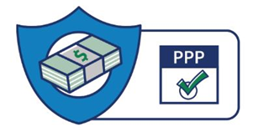
Who is eligible for the Paycheck Protection Program (PPP)
Eligible Businesses:
Small business with fewer than 500 employees. Businesses with greater than 500 employees must meet SBA size standards.
501(c)(3) nonprofits, 501(c)(19)Veteran organizations, Tribal business concerns described in section 31(b)(2)(C)
Churches (if all other eligibility requirements are met)
Sole proprietors, individuals that work as 1099 independent contractors, and self employed
Some businesses that receive part of revenue from legal gaming
Some exceptions have been made for accommodation and food service companies that have multiple locations

Slide 9
Paycheck Protection Program (PPP)
How to apply:
Apply through lenders that are authorized to process the PPP loans. All lenders who had the authority to process SBA loans are authorized along with many new lenders.
What an applicant needs to do:
Complete Borrower application SBA Form 2483: https://home.treasury.gov/system/files/136/PPP-Borrower-Application-Form.pdf
There is a helpful document called How to Calculate Loan Amounts (revised 6/26/2020) available on the Treasury website
Certify the form as to its accuracy and that of the information provided to the lender.
Certify “that the uncertainty of current economic conditions makes necessary the loan request to support the ongoing obligations” of the applicant

Slide 10

Paycheck Protection Program (PPP)
What a lender does to accept a PPP application
Collects Borrower application SBA Form 2483 and the appropriate payroll records and information
Conducts a review of the payroll records and borrower information
Completes any required due diligence regarding the applicant.
Completes Lender Application SBA Form 2484
Enters the information online through the SBA Etran system
Once an approval is made, closes the loan with the appropriate loan closing documents and authorization within 10 days
These are processed very quickly!

Slide 11

Paycheck Protection Program (PPP)
Forgiveness
How forgiveness is determined:
Forgiveness is based on the success of the employer in retaining its FTE employees and maintaining compensations levels within 25% of pre-disaster
  For the covered 8-week or 24-week period, the employer’s costs are determined. Payroll costs plus eligible nonpayroll costs may be forgiven. Any loan balance after forgiveness is termed out.
  If an employer is not able to meet the expectations of the program with adequate documentation, loan forgiveness amount will be discounted accordingly. However, partial forgiveness is possible
  There are ‘safe harbors’ for businesses that were unable to bring back employees due to qualified circumstances. Those are outlined in the forgiveness application instructions at www.treasury.gov/cares .
  The forgiveness amount will not allow nonpayroll costs to make up more than 40% of the forgiveness.
Notes:
The beginning date can also be the first payroll period after the disbursement.

Slide 12
Paycheck Protection Program (PPP)
Forgiveness
What is considered a payroll cost for loan forgiveness :
  Salary, wages, commissions, or similar compensation
  Cash tips or the equivalent (based on employer records of past tips or, in the absence of such records, a reasonable, good-faith employer estimate of such tips);
  Payment for vacation, parental, family, medical, or sick leave;
  Allowance for separation or dismissal;
  Payment for the provision of employee benefits consisting of group health care coverage, including insurance premiums, and retirement;
  Payment of state and local taxes assessed on compensation of employees; and
  For an independent contractor or sole proprietor, wage, commissions, income, or net earnings from self-employment or similar compensation.

Slide 13
Paycheck Protection Program (PPP)
Forgiveness
Non-payroll costs that are eligible for forgiveness:
  Rent on building or other leases established before 2/15/2020
  Utility payments under service agreements dated before 2/15/2020 (heat, water, telephone, internet)
  Interest on business mortgage and any other debt obligations established prior to 2/15/2020.
  For nonpayroll costs, the forgiveness can apply to amounts that are both incurred and paid during the covered period AS WELL AS, for costs paid for in the first billing cycle AFTER the covered period.

Slide 14
PPP Forgiveness Process
Borrower completes form 3508/3508EZ, or equivalent, and submits it to their lender.
The lender reviews the application and documentation and submits a decision to the SBA within 60 days of receipt of a complete application requesting payment for the forgiveness amount of the loan
SBA will remit the forgiveness amount to the lender within 90 days
If the borrower received an EIDL advance amount, SBA will deduct this from the total forgiveness amount.
Any amount not forgiven is payable pursuant to the note signed by the Borrower with a two or five-year maturity (if approved or amended on or after June 5, 2020) and a 1% fixed interest rate, subject to PPP loan payment deferment.

Slide 15
PPP - Forgiveness Process
The Forgiveness Application
3508 or 3508EZ. Do you qualify to use the streamlined form?
  Are self-employed and have no employees; OR
  Did not reduce the salaries or wages of their employees by more than 25%, and did not reduce the number or hours of their employees; OR
  Experienced reductions in business activity as a result of health directives related to COVID-19, and did not reduce the salaries or wages of their employees by more than 25%.
TIP … Streamlined Form 3508EZ Read the instructions and Checklist thoroughly. Complete the 1 page form.
Few calculations
Less documentation

Slide 16
Documentation Required to Meet Safe Harbor
If the FTE count is regained and/or the salary/hourly wages were restored to within 25% of 1st Qtr 2020 by December 31, 2020 or earlier
Document good faith offer to rehire and employee declines
  Must be written offer during the covered period at the same salary and hours as their last regular pay period
  Maintain record documenting offer and its rejection
  Notify state unemployment office within 30 days of the employee rejection
Document changes in head count for employees:
  Fired for good cause
  Voluntarily resigns
  Voluntarily requests a reduced schedule

Slide 17
PPP Forgiveness Daily Webinar
The SBA Vermont District Office hosts a free daily webinar from 9 to 10 a.m. Monday to Friday to discuss Paycheck Protection Program forgiveness and other changes.
To join the webinar, visit https://meet.lync.com/sba123/sbmazza/SFFM2N9R.
To join by phone, call (202) 765-1264 and when prompted enter the code 237511921#. Upon joining the call, mute the phone to cut down on the background noise and please do not place the call on hold as the hold music will be heard over the presenter.
For more information or any forgiveness questions,
please email susan.mazza@sba.gov.

Slide 18
Economic Injury Disaster Loan COVID-19 (EIDL)
Child Care Providers eligible
A direct loan from SBA to help cover about 6 months of operating expenses, capped at $150,000
Long term loan provides very low payments
11 month deferment at beginning of the loan
Low interest rates

Slide 19
SBA Economic Injury Disaster Loan (EIDL) COVID-19
EIDL - The Basics…
Apply directly to SBA online: https://covid19relief.sba.gov/#/
Loan amount decided by SBA)
No personal guarantees or collateral on loans up to $25,000
  Above $25,000 SBA will require collateral of business assets
    Real estate may be required to be pledged, if available
SBA will not decline a loan for lack of collateral, but requires borrowers to pledge what is available
Rates and terms:
  3.75% for small businesses
  2.75% for nonprofit organizations
  30-year term
  First 11 months of payments deferred. P & I begins at 12th month

Slide 20
SBA Economic Injury Disaster Loan (EIDL) COVID-19
Eligible uses of the EIDL funds?
Make payments on fixed debts, payroll, accounts payable, and other bills that could have been paid had the disaster not occurred
Can payoff short term and interim loans used in anticipation of receiving EIDL funding
Ineligible uses of funds?
Cannot refinance long term debt
Cannot pay dividends, bonuses, or make disbursement to owners unless it is usual/customary salary
Cannot repay stockholder loans
Cannot expand business or buy fixed assets
Cannot make repairs to real estate
Cannot be used to repay direct Federal Debt of any kind. Such as SBA Disaster loans, Educational loans, etc.
Cannot pay IRS past due obligations unless on an authorized repayment agreement.

Slide 21
Economic Injury Disaster Loan (EIDL) COVID-19
Information needed to apply:
Legal name of the business (if DBA, use name first and ‘tradename’)
Tax ID or SS# of the business
Opening date of business
Opening date of current ownership
Gross revenues for 12 months (2019 is fine)
Cost of goods sold for businesses, Operating expenses for nonprofits
(if applicable) Amount of rents LOST AS A RESULT OF DISASTER
SS #’s, date of birth and place of birth and contact info for all agent/owners
  This is required to verify that the applicants are verifiable human beings, and not robots developed to commit fraud
Business bank account number and routing number – all digits!
Ability to print or take a screenshot during the application

Slide 22
Economic Injury Disaster Loan (EIDL) COVID-19
Once the application is completed you are given the opportunity to edit/correct the application. It is VERY important that you review the information carefully.
  Make sure your email is correct and you are able to check it daily. Make sure you use a phone number (land line, cell) that you will have with you to respond to information requests promptly
After you hit submit, a confirmation page and application number pops up
  Print or take a screen shot and save the page with that number. That is your application number and will be needed for you to check status.
  You will NOT receive a confirmation email from SBA that the application is submitted.

Slide 23
Free Confidential Business Advising from SBA Partners
SBA Partners:
The following SBA funded partners will work with you to decide next best steps for your business. And if you are interested in PPP or EIDl, they can advise what would be best
Small Business Development Centers (SBDCs) www.vtsbdc.org
Women's Business Centers (WBC’s) www.cewonline.org
SCORE mentors www.scorevermont.org
Want to receive the latest information about SBA programs from your local SBA District Office?
https://www.sba.gov/local-assistance
    Click on the link on your state SBA page to sign up for the newsletter
Or contact us!
Darcy.carter@sba.gov or Susan.mazza@sba.gov

Slide 24

Questions?

