Slide 1

COVID-19 Guidance for
Emergency Child Care Services
Part 2
Breena Holmes, MD
Maternal and Child Health Director
April 7, 2020

Slide 2

A great many thanks
for all you are doing on behalf of children
and families in these complex
and uncertain times.

Slide 3
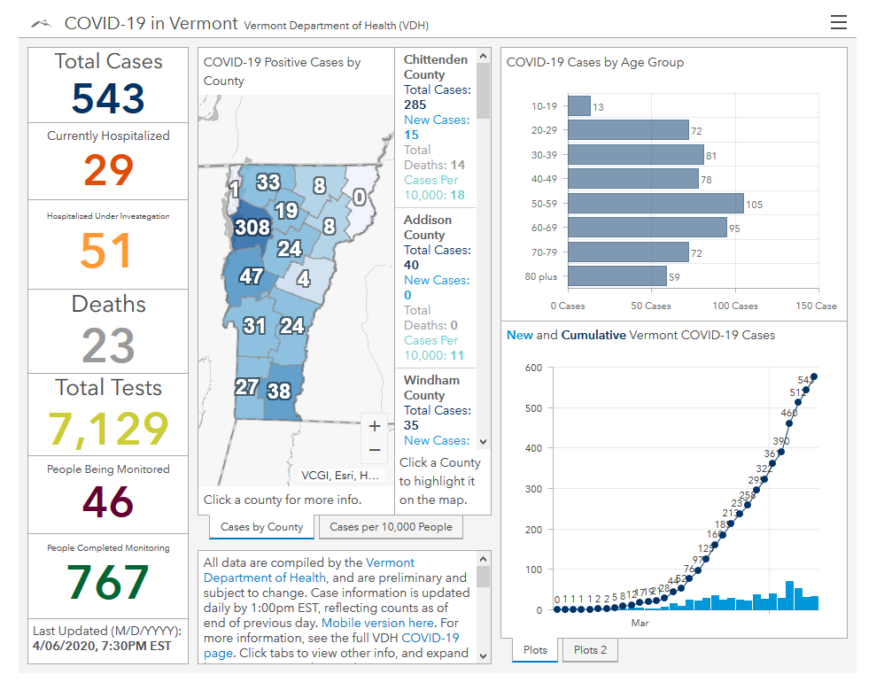
COVID-19 in Vermont
New Data Dashboard
Situational Awareness healthvermont.gov/covid

Slide 4

Important note:
The COVID-19 situation continues
to evolve very rapidly – so the information we
are providing today may change quickly

Slide 5
Exclude children, staff, parents and guardians from sites if they are showing symptoms of COVID-19, have been in contact with someone with COVID-19 in the last 14 days, or are at high risk due to underlying health conditions.

Slide 6
Close Contact
Close contact means being within six feet, for a long time, of someone who is diagnosed with COVID-19 during their infectious period, which starts one day before any symptoms began and continues until they are recovered.
Close contact does not mean: being more than six feet away in the same indoor environment for a long period of time, walking by, or briefly being in the same room.
Examples of close contacts | Examples of not close contacts
You live in the same home | You were their cashier at the grocery store
You are intimate partners | You are a pharmacist who gave the person medication
You rode in the same car while the person was infectious | You were in front of the person in line at the store
You had dinner together while the person was infectious | You’re a coworker who briefly walked by to ask a question

Slide 7
 | SELF-ISOLATION | SELF-QUARANTINE
For Whom? | People with symptoms of COVID-19 • For people with COVID-19 who aren’t sick enough to be hospitalized, or • For people who are waiting for test results | People with no symptoms of COVID19•Close contacts of people with COVID19
For How Long? | Until recovery, which happens when all three have happened: It’s been 3 full days of no fever without the use of fever-reducing medication, and Other symptoms have improved, and At least 7 days have passed since your symptoms first appeared. | For 14 days since the date of possible exposure. The day of the exposure is Day 0.
What does it mean? | Staying in a separate room in the house, using a separate bathroom, avoiding contact with others. | Staying home 24/7,monitoring for symptoms, and practicing social distancing. If possible, using a separate room and bathroom. If you become symptomatic, your close contacts should also self-quarantine.

Slide 8
New Health Guidance: HEALTH SCREENING
Conduct a Daily Health Check for the child(ren) attending childcare, and your staff:
  Have they been in close contact with a person who has COVID-19?
  Have they felt unwell with respiratory symptoms in the last few days? For example, have they had
  a cough, high temperature, shortness of breath, or difficulty breathing?
Temperature check protocol: Health screening should occur upon entrance and near sink.
Perform hand hygiene
Put on a cloth facial masks or coverings, eye protection, and a single pair of disposable gloves
Check individual’s temperature
If performing a temperature check on multiple individuals, ensure that a clean pair of gloves is used for each individual and that the thermometer has been thoroughly cleaned in between each check. If disposable or non-contact thermometers are used and the screener did not have physical contact with an individual, gloves do not need to be changed before the next check. If non-contact thermometers are used, they should be cleaned routinely
Remove and discard gloves in between children

Slide 9

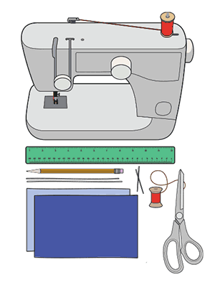

New Health Guidance: CLOTH FACE COVERINGS
It is recommended that all staff wear cloth face coverings while providing care.
Cloth face coverings should—
Fit snugly but comfortably against the side of the face
Be secured with ties or ear loops
Include multiple layers of fabric
Allow for breathing without restriction
Be able to be laundered and machine dried without damage or change to shape
Use of Cloth Face Coverings to Help Slow the Spread of COVID-19
cdc.gov/coronavirus/2019-ncov/prevent-getting-sick/diy-cloth-face-coverings.html

Slide 10
New Health Guidance: DROP-OFF & PICK-UP
Stagger arrival and drop off times and/or plan to limit direct contact with parents/caregivers.
Same parent or designated person should drop off and pick up the child every day.
Older people such as grandparents should not pick up their children, because they are more at risk for serious illness.
Hand hygiene stations could be set up at the entrance of the facility or the entrance process could be rerouted through a different entrance nearest the sink.
Parents and caregivers who are self-quarantining due to close contact with a COVID-19 positive individual should NOT do drop-off or pick-up.
Consider recommending that parents and caregivers who are heath care workers identify someone else to do drop-off and pick-up.

Slide 11
New Health Guidance: COVID CASES IN CARE
When there is a confirmed case of COVID in the childcare program, consult with the Vermont Department of Health. In partnership with the Health Department, the following should be considered:
Dismiss children and most staff for 2-5 days
Communicate with staff and parents/caregivers
Clean and disinfect thoroughly
Decisions about extending closure
➔ If there is a reduction in childcare capacity, notify CDD

Slide 12
New Health Guidance
SOCIAL DISTANCING STRATEGIES
Wherever possible, the same childcare providers should remain with the same group each day.
At nap time, place resting children head to toe in order to further reduce the potential for viral spread. Programs with sufficient space should place children 6 feet apart at naptime as much as possible.
TOYS & BEDDING
Clean playground equipment to the best of your ability
Toys that cannot be cleaned and sanitized should not be used, including items such as soft toys, dress-up clothes, and puppets.
Use bedding that can be washed (1x/week). Per childcare licensing regulations, children's bedding is required to be stored separately.

Slide 13



New Health Guidance: ADDITIONAL NEW ITEMS
Increased age of individuals that should not provide childcare during this time to Age 65
Additional updated guidance
Updated Healthy Hand Hygiene Behavior
Cleaning & Disinfecting
Caring for Infants and Toddlers
Food Preparation and Meal Service

Slide 14

Heath Guidance: GENERAL GUIDANCE REMINDER
Small groups, not more than 10 individuals in a classroom, including teachers
Absolutely no large group activities
Frequent handwashing with soap and water for at least 20 seconds
Frequent thorough cleaning each day
No outside visitors and volunteers

Slide 15
Health Questions Resource for Childcare Services
The Department of Health has public health nurses available to childcare programs and school providing childcare services to answer health related childcare questions
8:00 AM to 3:00 PM Monday through Friday
Call: 802-863-7240, select the option for “Childcare Services”
After hours there will be a childcare question mailbox to leave a message and VDH staff will return your call the following business days.

Slide 16

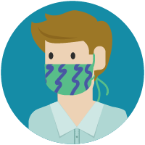

Where can I get needed supplies?
Getting programs access to cleaning supplies, such as gloves, masks, and hand sanitizer is currently being coordinated by CDD and Let’s Grow Kids, in partnership with the State Emergency Operations Center (SEOC).

Slide 17
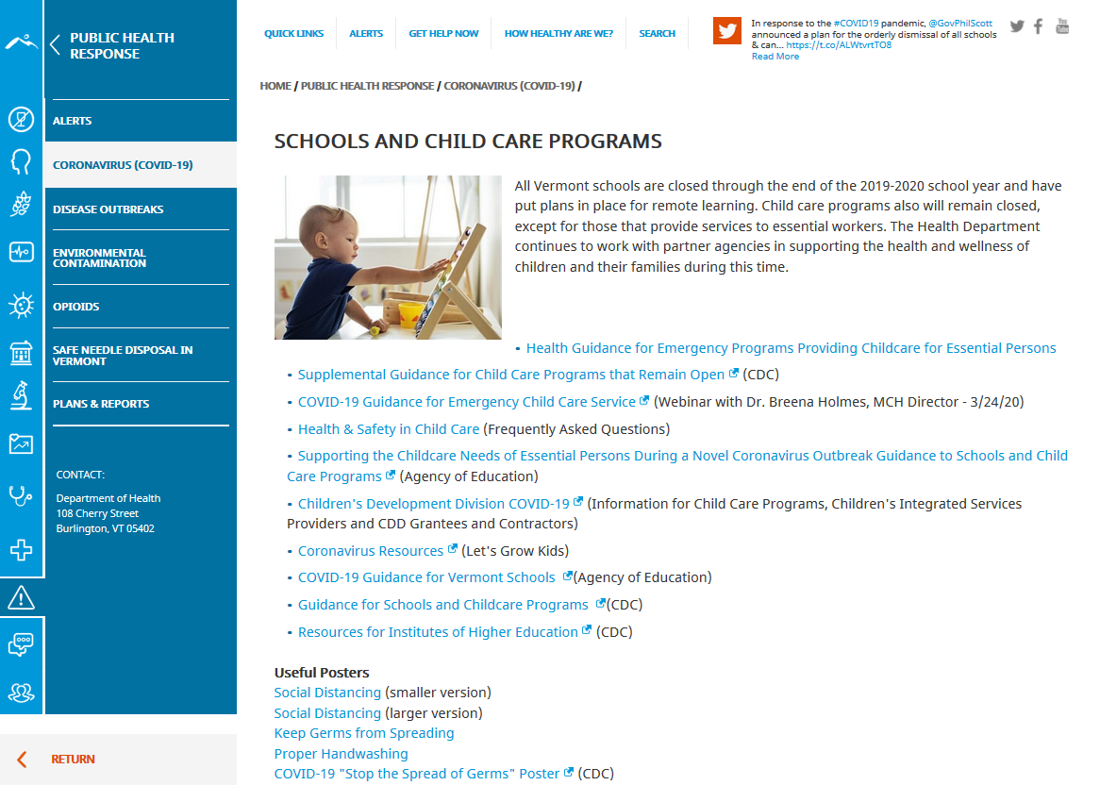
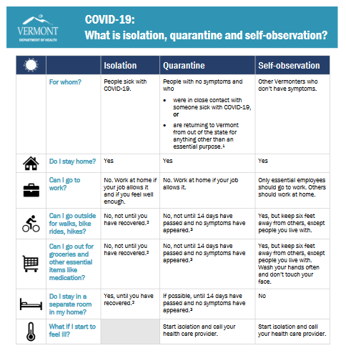
VDH Resources & Tools: healthvermont.gov/covid

Slide 18


Slide 19
Maternal and Child Health (MCH) is here to support the health and safety of your program, your staff and the families your serve.

Slide 20
Breena.Holmes@vermont.gov

