Slide 1

COVID-19
Early Care and Education Providers
Breena Holmes, MD
Maternal and Child Health Director
August 4th and August 6th 2020

Slide 2

A great many thanks
for all you are doing on behalf of children
and families in these complex
and uncertain times.

Slide 3

Important note:
The COVID-19 situation continues
to evolve very rapidly – so the information we
are providing today may change quickly

Slide 5
Objectives
Review Revisions to Health Guidance for Childcare and School Age Camps/Care
Review Safe and Healthy Schools Re-Opening Guidance
Questions and Answers from you

Slide 6
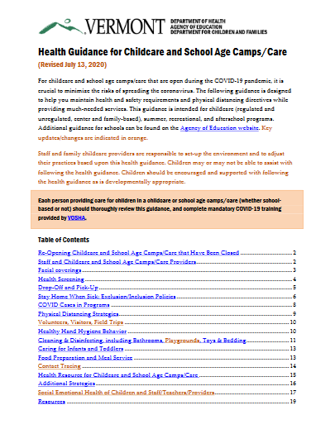
Updated Guidance:
Health Guidance for Childcare and School Age Camps/Care
:: Revised July 13 ::

Slide 7
What Parents Can Expect : During the Day
Staff will be wearing cloth facial coverings all day
Facial coverings recommended for children 2+, with exceptions for medical and developmental reasons
Daily symptom monitoring and temperature check
Frequent thorough cleaning each day
Small groups preferred (pods of 25) per classroom—staff and children
Programs may maintain operations up to the total occupancy limits for their programs
Absolutely no large group activities
No outside visitors and volunteers, with exception of health and safety, interns, etc.
New VOSHA regulations:
All common spaces and equipment, including bathrooms, frequently touched surfaces and doors, tools and equipment, and vehicles must be cleaned and disinfected at the beginning, middle and end of each shift and, when possible, prior to transfer from one person to another.

Slide 8
What Parents Can Expect : Exclusions
The following children and staff will be EXCLUDED from care:
  Showing signs/symptoms of COVID-19
  Have been in close contact with someone with COVID-19 in the last 14 days
If symptoms begin while at the childcare and school age camp/care, the child WILL BE sent home as soon as possible
Individuals with a temperature greater than 100.4 F will be sent home until they have had no fever for 24 hours without the use of fever-reducing medications (e.g., Advil, Tylenol)

Slide 9
Guiding Principles/Concepts in Safe and Healthy Schools
State (AOE-VDH) Safe and Healthy Schools Guidance and School District Implementation
Plan, Do, Study, Act (PDSA)- quality improvement
Encourage all citizens to follow public health guidance to keep community transmission low

Slide 10
Vermont Safe and Healthy Schools Guidance
Vermont Department of Health & Vermont Agency of Education: guidance: education.vermont.gov/documents/guidance-strong-healthy-start-health-guidance - June 17, 2020
Revision anticipated on or about August 7th
PowerPoint presentation (for anyone's use) healthvermont.gov/sites/default/files/documents/pdf/COVID19-Safe-Healthy-Schools-Guidance-Summer-Slides.pdf

Slide 11
Science, Pediatricians, Infectious Disease Specialists and Vermont
Children are less likely to become infected;
Children are less likely to develop severe disease;
Critically, children, particularly younger children, seem less likely to transmit the virus that causes COVID-19; and
Countries with low COVID-19 prevalence rates, similar to that seen in Vermont, have successfully opened schools without outbreaks of COVID-19.

Slide 12
Safe and Healthy Schools Task Force
VT Superintendents Assoc
VT Principals Association
VT Independent Schools Assoc
VT School Nurses Association
VT—National Educational Assoc
VT Council of Special Education Administrators
VT Child Health Improvement Program (VCHIP)
UVM Children’s Hospital/Infectious Disease
General Pediatrician, South Royalton
VT Assoc of School Psychologists
DMV/Pupil Transportation Services
Agency of Education
Vermont Department of Health

Slide 13
Safe and Healthy School Guidance Review
Parent Representative through School Nurses connections
Vermont Afterschool 9-26 Coalition youth
VT RAYS adolescent advisory group
Teachers through Vermont NEA
Pediatrician colleagues with geographic diversity

Slide 14
Objectives for School Health in the COVID Era
Decrease risk of individuals infected with COVID-19 from entering the school
Decrease transmission of COVID-19 among staff and students
Quickly identify individuals with COVID-19 and put containment procedures in place
Ensure that the special needs of students with physical, emotional and behavioral concerns are thoroughly addressed in a fair and equitable manner
Communicate regularly with staff, students, families and the community
Ensure that COVID-19 health guidance safeguards an equitable educational experience for all students

Slide 15

Mission Critical to Re-Open Childcare and Schools
Learning
Social emotional well-being
Connection
Access to healthy food
Supports for children and youth
in difficult home situations
Physical Activity

Slide 16
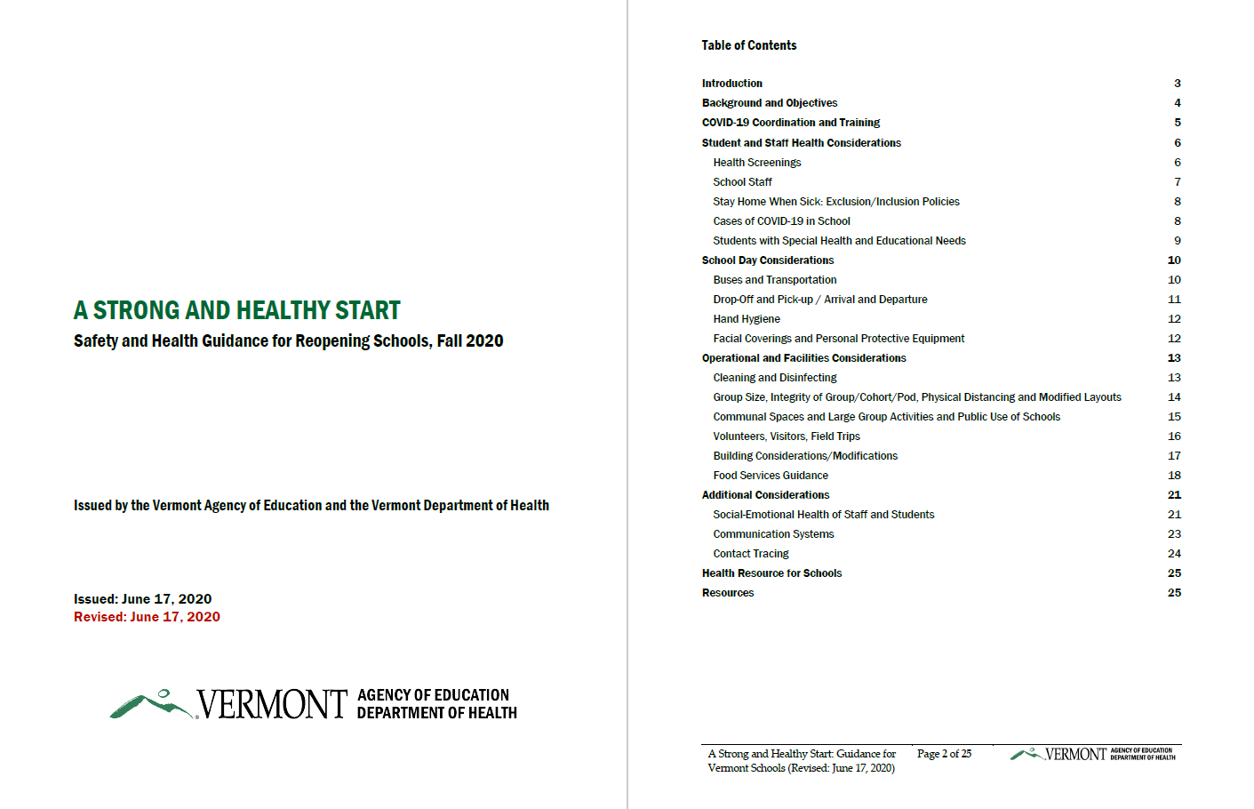
Safety & Health Guidance for Reopening of Schools,
Fall 2020
education.vermont.gov/documents/guidance-strong-healthy-start-health-guidance

Slide 17
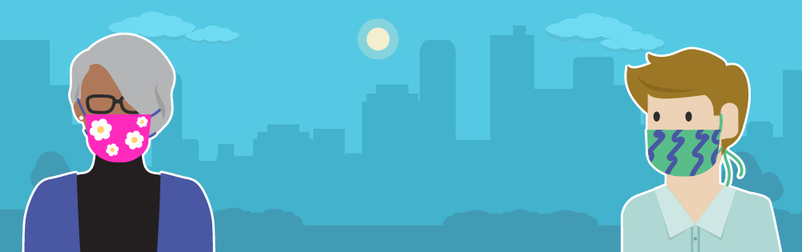
Cloth Facial Coverings: REQUIRED for staff, students and all others
  Facial coverings are developmentally appropriate when children can properly put on, take off, and not touch or suck on the covering. PreK students require special consideration regarding age and child development.
  No cloth facial coverings while sleeping, eating or swimming.
  Help children to understand the importance of wearing cloth facial coverings to prevent the spread of germs.
  Facial coverings may be removed during outdoor activities where students and staff can maintain physical distancing and have ready access to put them back as needed when activity stops.
  Students who have a medical or behavioral reason for not wearing a facial covering should not be required to wear one. These decisions should be made in partnership with the health care provider and school nurse.

Slide 18
Group Size, Integrity of Group/Cohort/Pod, Physical Distancing and Modified Layouts
Step II
  Keep classes together to include same group of students & teachers each day (middle and high school may need to be addressed differently)
  Restrict mixing of groups
  Space seating to 6 feet apart
  Turn desks to face same direction
  Require students to stay in an assigned section of the school yard
  Hold virtual meetings with students, families and staff
Step III
  Consider keeping classes together to include the same group of students each day
  Continue to space out seating and bedding to 6 feet apart, to the extent possible
Additional Tips
  Move classes outdoors
  Minimize traveling to different buildings
  Broadcast in-class instruction to multiple rooms
  Implement homeroom stay where teachers rotate
  Discourage use of attendance awards/incentives
  Rearrange furniture to avoid clustering in common areas

Slide 19

Help Me Grow Creates a Reliable Grid of Resources
Help Me Grow offers a resource hub that helps connect children and their families to local resources and services
Providers wanting to refer a family directly to resources themselves can call HMG staff to
get the latest information on food resources, mental health services and support groups,
and more
Dial 2-1-1 ext. 6, text HMGVT to 898211, or refer at helpmegrowvt.org/form/referral-form

Slide 20
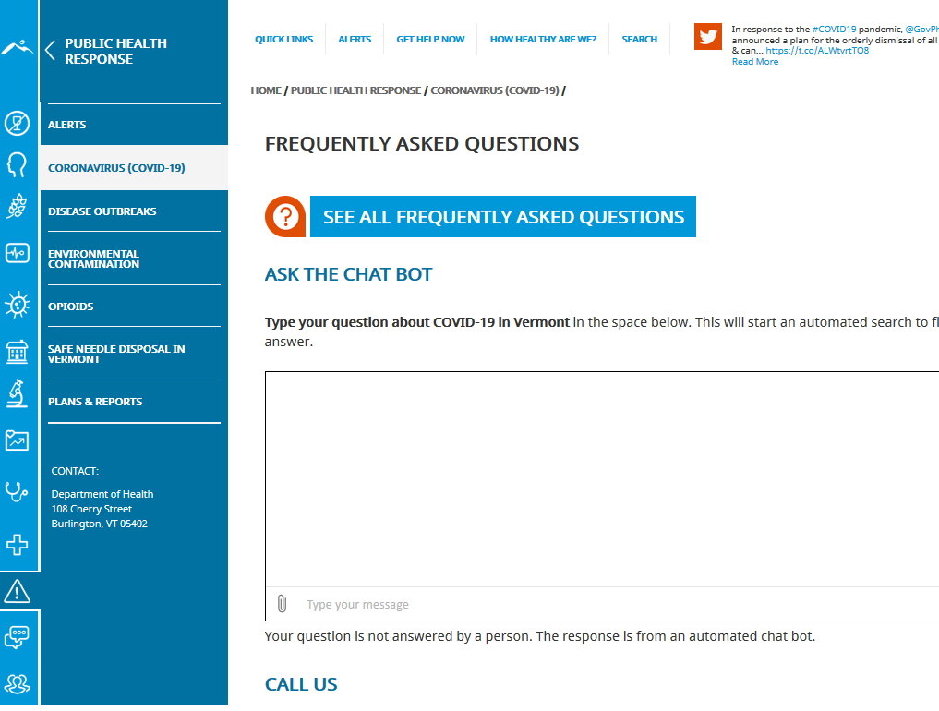
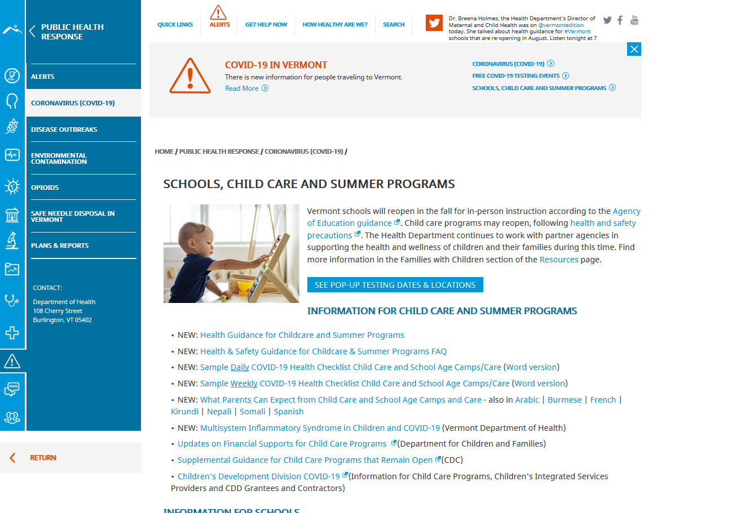
Health Department Resources & Tools: healthvermont.gov/covid

Slide 21
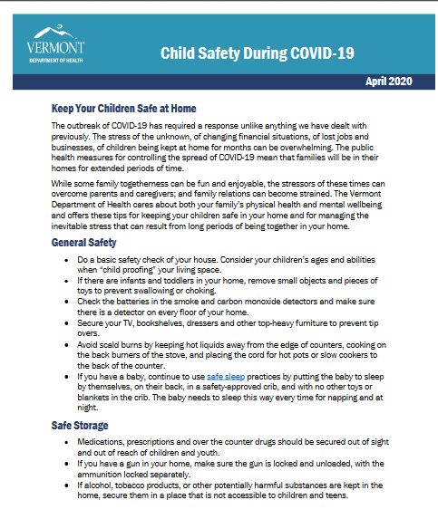
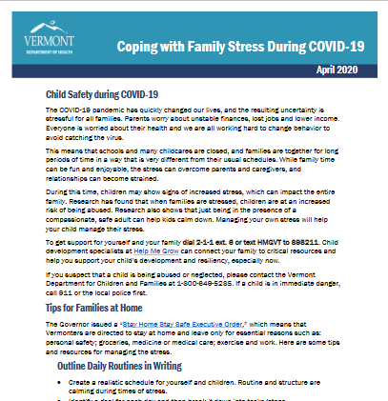
Health Department
Resources for Children and Families
Coping with Family Stress
Child Safety
Suicide Prevention
Domestic & Sexual Violence
Prevention

Slide 22


Slide 23
Your Questions
Social distancing - we seem to be waffling and some people are saying 3' vs 6'? This is especially concerning for rest time when children will not be wearing masks.
School teachers are supposed to stay in a teaching bubble, what about pre-k teachers? Our kids cannot stay in desks all day, nor should they, so what is the answer? Fewer kids? Is anybody operating at full capacity?
Please put to rest the question about little kids not spreading the virus like adults and older children. Are they really more asymptomatic?
What is working in centers now open? We need more details on cleaning toys and systems that are working.

Slide 24
Your Questions
It seems that at least some of the outcomes cited were based largely on the time at which adults and children tested positive for COVID-19. I keep thinking to myself that it seems possible or even likely that some of the children may have had the virus but were asymptomatic, then transmitted it to their parents who then exhibited symptoms and were therefore tested and found to be positive cases before having the children tested.
I just can’t shake the feeling that just because the adults were tested before the children, that doesn’t necessarily mean that they contracted the virus before the children did, given the tendency for children to be asymptomatic. I’m concerned about the possibility of children in the classroom being asymptomatic but still spreading the virus to their peers or to the adults in the classroom, many of whom are higher risk. What is your opinion about the extent to which transmission seems to occur from adult to child but not the other way around; or from child to child?

Slide 25
Your Questions
What is the guidance around parents coming into the program with their child, particularly for the first few days when children are entering a strange program with people they don't know who are wearing masks?
Several kids came down with symptoms, saw doctors and got Covid tested. All that done and having Negative results, how do we approach the child still having a consistent light cough , runny nose from what was a cold? If it lingers on past a week, at what points/symptoms do we excude or does it completely revert back to the health regs we normally follow as deemed by the Licensing Division? At what point does the previous Covid test become invaid?
Many providers are using aerosol Lysol spray on toys. Is this effective?
A child stayed home from our program earlier in the week with a runny nose and returned today. During the health screening, the child showed no signs/symptoms of illness or a runny nose. We remained outside the entire time the child was at our program and while we were outside, the child developed a runny nose. Is a runny nose a reason to call a parent to come pick up a child from the program?
Can essential oil diffusers be used safely during inside time or is the goal to reach a recommended humidity level with the use of a dehumidifier? And what about the use of air filters in classrooms? Could this be part of the plan to help protect ourselves?

Slide 26
Breena.Holmes@vermont.gov

